Slide 1

MINOR-1 PROJECT
Under the guidance of
Mr. Deepak Kumar Sharma
Assistant Professor
Department of Informatics

Slide 2
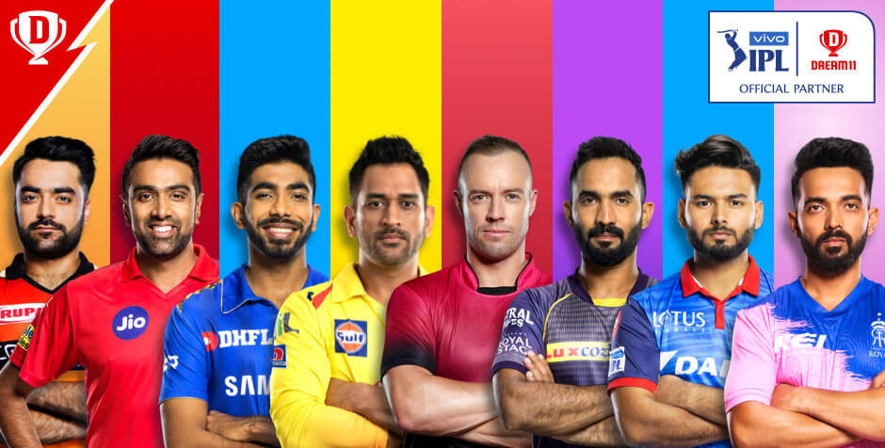
Player selection using clustering algorithm
Presented by:
Lakshay Vasuja(500067177)
Lakshay Sharma (500068760)
Divyansh Chandna(500068095)

Slide 3
Introduction
IPL also known as Indian Premiere league launched in 2008 by BCCI is a professional Twenty20 cricket league in India. IPL consists of 8 different teams representing 8 different cities in India. Players from all over the world take part in this tournament.
Players are selected through auctions for every team so some situations can arise where the team doesn’t get their desired player like the bid has maxed out the team’s budget for the particular player and there can be a number of situations where this can happen.

Slide 4

Problem statement
There can be a number of situations where desired players cannot be picked during auction so a substitute player has to be picked.
To make a good and versatile team with different properties is a hard task as team management have to keep track of all the players and bid on them.
Sometimes Captains cannot make a well informed decision on what to choose after winning the toss.

Slide 5

Objective
Use K-Means clustering algorithm to create clusters of players based on their similar properties.
Implementation of K-Means to create clusters of players
Making an IPL team for the user and adding functionalities like modifying the selected teams and deleting previous selected teams and searching players in the teams etc.
Calculate the probability between toss winning vs match winning taking in account different parameters like toss decision, venue, weather conditions etc.

Slide 6
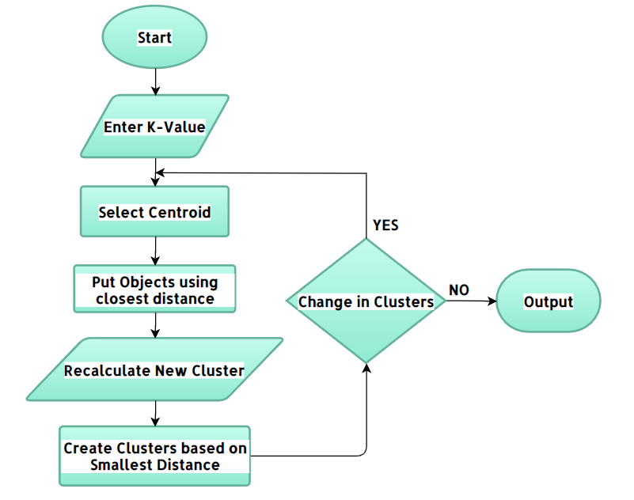
k-means Clustering
K-means clustering is one of the simplest and popular unsupervised machine learning algorithm.

Slide 7
K-Means clustering algorithm
Algorithm
Choose the number of clusters(K) and obtain the data points
Place the centroids c_1, c_2, ..... c_k randomly
For each data point x(i):
find the nearest centroid(c_1, c_2 .. c_k) using Euclidean distance
assign the point to that cluster
For each cluster i= 1..k
new centroid = mean of all points assigned to that cluster
Repeat steps 4 and 5 until convergence or until the end of a fixed number of iterations.
End

Slide 8
Methodology
Predicting the events that may happen IPL follows the past. Cleaning the data and making it ready for the analysis will be the first step.
We start with a first group of randomly selected players(centroids), which are used as the beginning points for every cluster
Iterative calculations are performed to optimize the positions of the players in the clusters.
Now the clusters are formed the players are ready to be selected.
After selection of players, the dream team is formed.

Slide 9
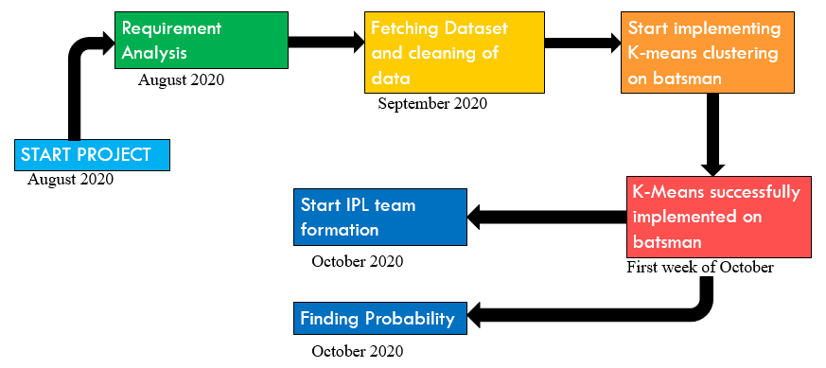
Pert chart

Slide 10
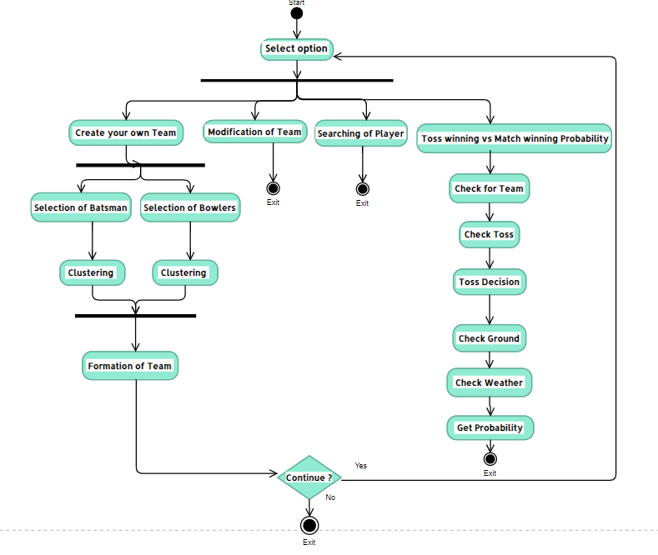
Activity diAGRAM

Slide 11
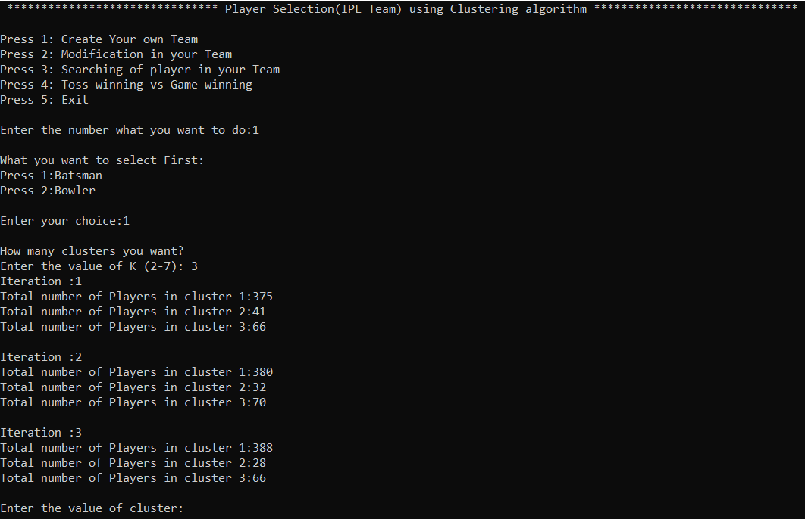
Results

Slide 12
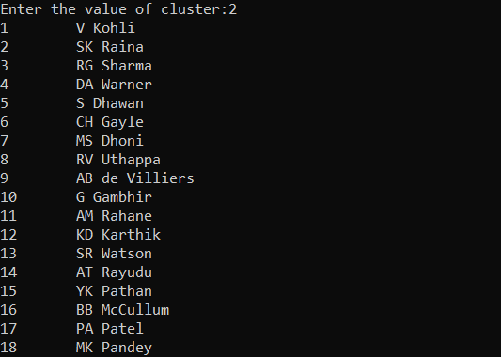
Snapshot of cluster 2 batsman (cluster can be of choice)

Slide 13
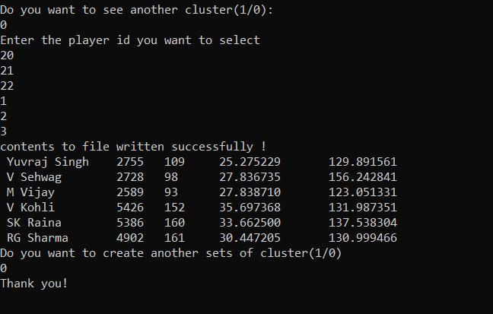
Choose batsman according to choice and store in file

Slide 14
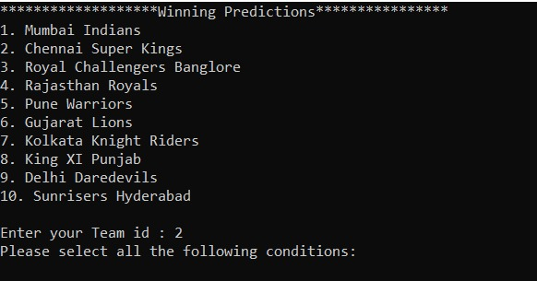
Selecting Team for finding probability

Slide 15
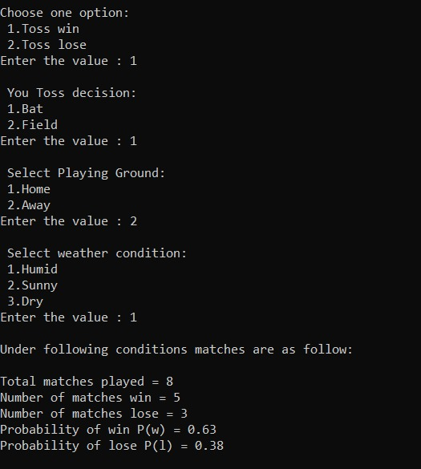
Getting probability under following conditions

Slide 16
Reference links
https://www.researchgate.net/figure/Flowchart-of-k-means-clustering-algorithm_fig2_271915066
https://online.visual-paradigm.com/w/bqbcvvxe/diagrams/#diagram:proj=0&type=Flowchart
https://www.dream11.com/

